Slide 1


Quick & Clean marketing plan mkt 6301.502
Andrew Donald
Linnley Smith
Paulina Mahajan
Mohit Jain
Rauf Mardiyev

Slide 2



We’re quick & clean, your mobile car wash service
Quick & Clean is a mobile car wash organization that offers an extensive variety of services that center around car detailing and other related cleaning services.
Our service travels to our customers through requested appointments or onsite partnerships with local businesses.
We offer a waterless wash experience that is ecofriendly and conserves 50-100 gallons of water per car.

Slide 3
Marketing objectives
Enter New Local Market & Target New Customers
Reach 80% of the Richardson area with at least one ad impression for the first year.
Limit initial service area to retain control.
Ability to experiment with different kind of marketing campaigns.
Build Brand Awareness in Potential Future Markets
Reach 80% of the population in 3-5 nearby DFW cities with at least one ad impression for the first year.
Use data from initial customer base to find other areas to penetrate.
Grow Digital Presence
Gain at least 2000 email addresses and social media followers.
Will focus more on our brand’s digital presence to reach target market.
Funnel all business though self-designed mobile application.

Slide 4
Marketing objectives
Develop Brand Loyalty
Acquire at least 100 return business customers in the first year through rewards program or mobile application.
Stress high quality service that puts customers’ needs and opinions first.
Specific targeting for promotions and discounts based on prior purchases.
Launch New Products & Services
Introduce at least two new automobile services; oil changes, windshield repair.
Future expansion of our service line to better serve the needs of our customers.
Build Industry Authority
Earn a competitive market share with other car cleaning services within the first two years.
Leverage successful sales data to expand and eclipse top competitors in the first five years.

Slide 5
Target Markets
DEMOGRAPHIC
GEOGRAPHIC
PSYCHOGRAPHIC
SITUATIONAL ANALYSIS
18-30 years old students and blue-collar workers use more self-service facilities.
Dallas is ranked fourth by increase in the number of “Gen Z” renters.
About 43% of target customers lease their cars.
Basic need of premium car wash at the customer’s convenience.
High income group of white collar workers who are car owners.
UTD is 70% “Gen Z” with a blend of “Gen X”.
Different types of car wash facilities appeal to different ages.
Waterless car wash that is easily mobile.

Slide 6
Swot analysis
Corporate branding
Eco-friendly
Moderate Pricing
Social media presence
Business park
partnerships
Need for funding
Absence of prior experience
First months business at risk to cover expenses
STRENGTHS
WEAKNESSES
THREATS
OPPORTUNITIES
Severe weather conditions
Potential future competition
Customer perception of hand wash value
Heavy potential customer area
UTD’s low cost labor pool
Lower expenses as business increases

Slide 7
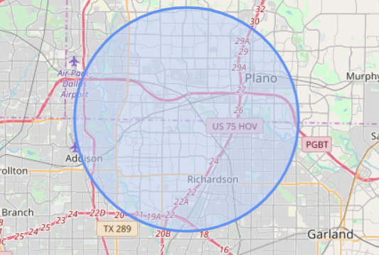
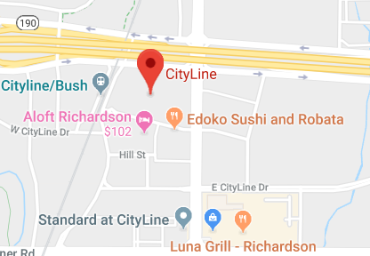
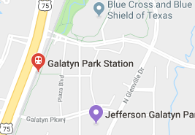
distribution
AREA OF SERVICE
Quick & Clean will use The University of Texas at Dallas as its base and will only accept appointments within a 5 mile radius.
Quick & Clean has arrangements with local business parks to offer car washes to their occupants on certain days.
CityLine – First Wednesday of every month
Galatyn Park Urban Center – Third Wednesday of every month

Slide 8
pRICING strategy
FIRST PHASE PRICING STRATEGY
Penetrate our target market by offering Q&C Silver Wash at $25 for the first three months of operation.
SECOND PHASE PRICING STRATEGY
Offer promotional periods featuring discounts on different wash tiers or free additional service with purchase.

Slide 9
Service tiers
Q&C SILVER
Q&C GOLD
Q&C PLATINUM
Full exterior hand wash
Tire dressing & rim cleaning
Exterior & interior window cleaning
Thorough interior & trunk vacuum
Interior wipe down
Door jambs
Glossy exterior finish
Time Required: 60 mins.
Full exterior hand wash
Tire dressing & rim cleaning
Exterior & interior window cleaning
Thorough interior & trunk vacuum
Interior wipe down
Door jambs
Complete wax for protect & shine
Leather cleaning & conditioning
Light stain removal
Time Required: 90 – 100 mins.
Full exterior hand wash
Tire dressing & rim cleaning
Exterior & interior window cleaning
Thorough interior & trunk vacuum
Interior wipe down
Door jambs
Complete wax for protect & shine
Leather cleaning & conditioning
Light stain removal
Clay bar paint treatment
Water spot removal
Outside plastic dressing
Mats & carpets shampooed
Plastic dressing inside
Time Required: 120 mins. or more
Lowest tier wash at $29.99
Mid-tier wash at $60
Highest tier wash at $100

Slide 10
Additional Services
Bug, Tar, Sap Removal $25+
Pet Hair Removal $25+
Carpet Wash $10+
Clay Bar Treatment $70+
Tail Pipe Polish $10
Premium Fragrance $5
POSSIBLE FUTURE SERVICES
Hail Damage Repair
Oil Changes
Car Seat Detail
Window Tinting & repair

Slide 11
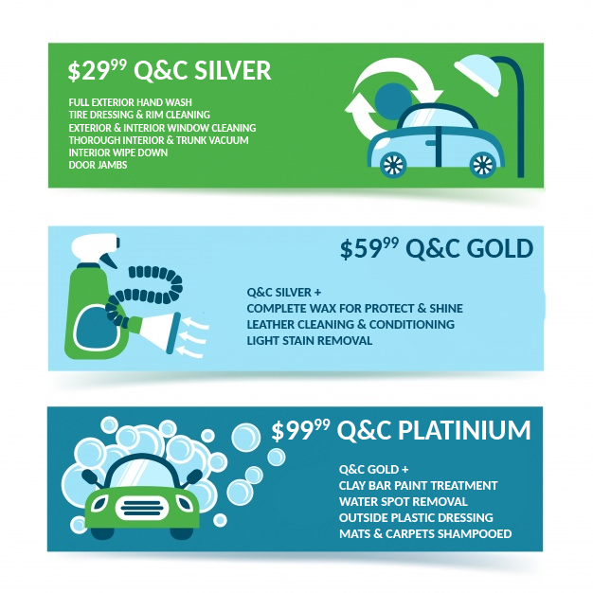
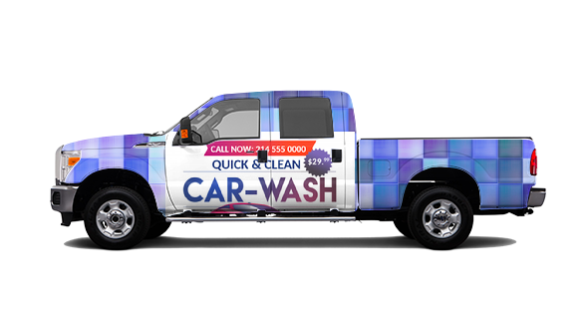
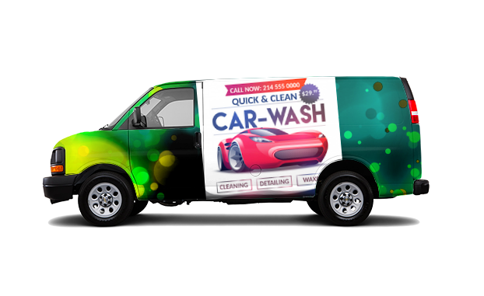
Signage

Slide 12

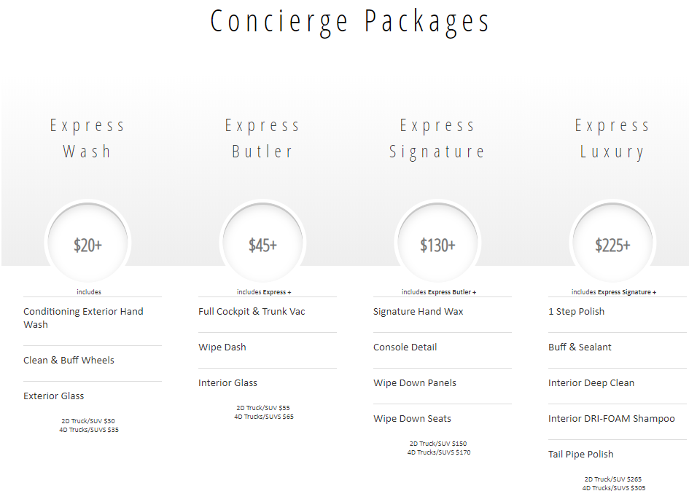
Competitors
Sparkle and Shine
www.sparklenshineautodetail.net
Sparkle & Shine is a direct competitor that uses a similar waterless and eco-friendly product.
They currently operate in Addison at Galleria Tower North.

Slide 13
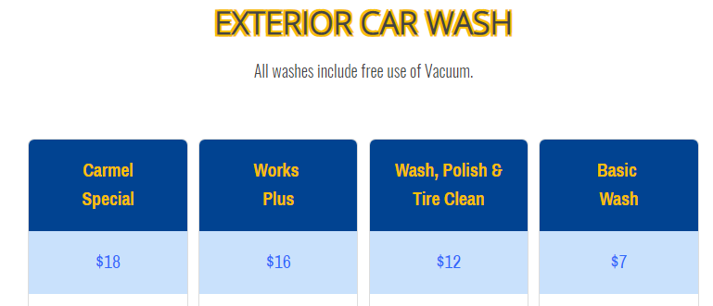

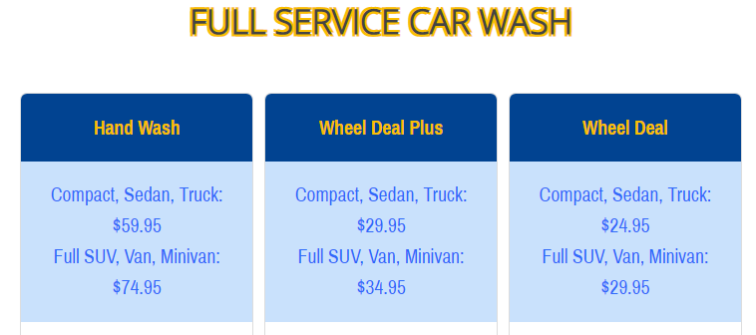
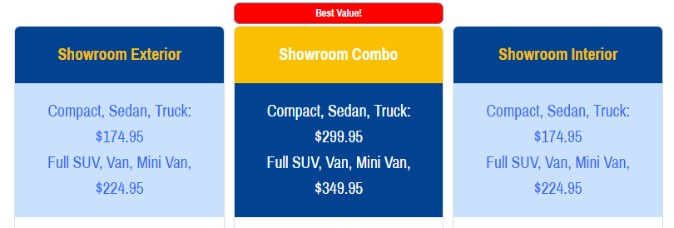
Competitors
Carmel Car Wash
www.carmelcarwash.com
Carmel Car Wash is an indirect competitor as a car wash facility with nine locations throughout the DFW metroplex.
Carmel Car Wash offers a variety of different packages, but the customer must visit their location for services.
Pricing varies from just exterior washes with customer use of vacuums for only $7 to top detailing packages for $300.

Slide 14
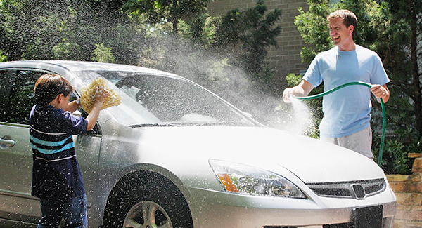
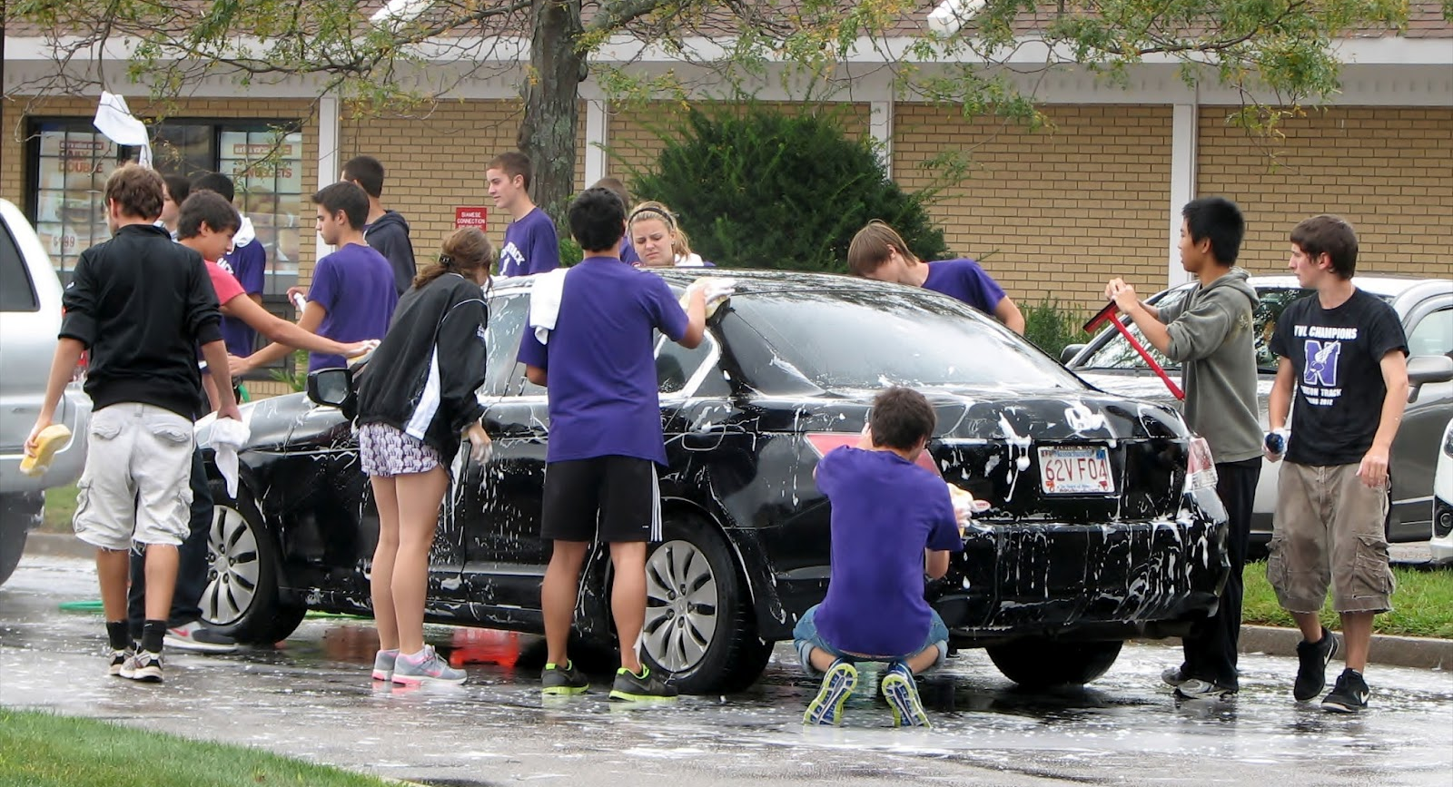
Competitors
DIY Car Washing & Fundraisers
Some clients may prefer to clean vehicles on their own or participate in fund raisers driven by car washing. These indirect competitors will require a higher perceived value when approached with our mobile car wash service. We will counter this by promoting the time savings and convenience factor provided by Quick & Clean.

Slide 15
Hours of operation
Quick & Clean’s hours of operation are dependent on daylight hours and will be adjusted throughout the year by seasons. This information will be advertised clearly on all publications to eliminate any confusion.
SPRING |  | SUMMER |  | FALL |  | WINTER
MARCH | 8 AM TO 6 PM | JUNE | 8 AM TO 8 PM | SEPTEMBER | 8 AM TO 7 PM | DECEMBER | 8 AM TO 5 PM
APRIL |  | JULY |  | OCTOBER |  | JANUARY
MAY |  | AUGUST |  | NOVEMBER |  | FEBRUARY

Slide 16
Projected Financials
First Year

Slide 17
Projected Financials
First Year
INCOME
 | MARCH | APRIL | MAY | JUNE | JULY | AUGUST | SEPTEMBER | OCTOBER | NOVEMEBER | DECEMBER | JANUARY | FEBRUARY | TOTAL
INCOME | $36,270 | $33,930 | $36,270 | $42,120 | $40,716 | $40,702 | $35,955 | $33,745 | $36,036 | $41,278 | $44,226 | $41,278 | $462,525
BAD WEATHER DEDUCTION | -$10,230 | -$9,570 | -$10,230 | -$11,880 | -$11,484 | -$12,276 | -$10,890 | -$11,253 | -$10,164 | -$11,642 | -$12,474 | -$11,642 | -$133,736
EXPENSES
 | MARCH | APRIL | MAY | JUNE | JULY | AUGUST | SEPTEMBER | OCTOBER | NOVEMEBER | DECEMBER | JANUARY | FEBRUARY | TOTAL
MARKETING | $2,840 | $2,300 | $2,840 | $1,200 | $1,400 | $1,200 | $1,220 | $1,000 | $1,300 | $1,500 | $1,700 | $1,500 | $20,000
COGS/COS | $18,975 | $16,625 | $17,875 | $20,800 | $19,670 | $21,130 | $19,225 | $19,303 | $17,770 | $20,422 | $21,245 | $20,122 | $233,162
TRAVEL | $1,395 | $1,305 | $1,395 | $1,350 | $1,305 | $1,395 | $1,350 | $1,350 | $1,305 | $1,305 | $1,305 | $1,260 | $16,020
LEGAL | $2,000 |  |  |  |  |  |  |  |  |  |  |  | $2,000
INSURANCE | $400 | $400 | $400 | $400 | $400 | $400 | $400 | $400 | $400 | $400 | $400 | $400 | $4,800
TAXES | $3,343 | $3,179 | $3,261 | $3,754 | $3,754 | $3,754 | $3,261 | $3,261 | $2,941 | $2,941 | $3,015 | $2,868 | $39,332

Slide 18
Projected Financials
First Year
SUMMARY
 | MARCH | APRIL | MAY | JUNE | JULY | AUGUST | SEPTEMBER | OCTOBER | NOVEMEBER | DECEMBER | JANUARY | FEBRUARY | TOTAL
INCOME ADJUSTED | $26,040 | $24,360 | $26,040 | $30,240 | $29,232 | $28,426 | $25,065 | $22,492 | $25,872 | $29,635 | $31,752 | $29,635 | $328,789
EXPENSES | $28,953 | $23,809 | $25,771 | $27,504 | $26,529 | $27,879 | $25,456 | $25,314 | $23,716 | $26,568 | $27,665 | $26,150 | $315,314
NET SAVINGS | -$2,913 | $551 | $269 | $2,736 | $2,703 | $547 | -$391 | -$2,822 | $2,156 | $3,067 | $4,087 | $3,485 | $13,476
ENDING BALANCE | $27,087 | $27,638 | $27,907 | $30,643 | $33,346 | $33,893 | $33,502 | $30,681 | $32,837 | $35,904 | $39,991 | $43,476

Slide 19
implementation
First Quarter
March 2019
Acquire funding
Hire part time employees
Register Quick & Clean in local directories
Publish website, promo materials, social media
Begin first phase of pricing strategy
May 2019
Start weekly contest on website
Start analyzing customer data
Sponsor UTD on campus events
End of first phase pricing strategy
Evaluate to move into second phase pricing
April 2019
Start online advertising campaign
Promo flyers for Earth Day and Spring to highlight eco-friendly car washes

Slide 20
implementation
Second Quarter
June 2019
Shift focus from UTD to surrounding neighborhood
Begin Summer promotions
Enter summer season with longer hours of operation.
Enter second pricing strategy if approved
August 2019
Launch online ad campaign to target new students
Sponsor Weeks of Welcome events at UTD
Offer Back to School promotions
Perform 6 month evaluation and financial projection review
July 2019
Mid-Year Discounts
Target businesses over residential areas this time of year

Slide 21
implementation
Third Quarter
September 2019
Start on campus housing campaign
Begin blog on carwash tips and creative content to drive customers to our website
Begin forecasting for Year Two sales goals and budgets
November 2019
Enter into winter for the busy season
Promotional activities during local sports games & Homecoming events
Implement Thanksgiving and Black Friday discounts
October 2019
Decrease hours of operation due to less daylight
Print and distribute Halloween promotions

Slide 22
implementation
Fourth Quarter
December 2019
Focus on neighborhoods and businesses during school break
Gift Card promotions for the holidays
Drive aggressive promotions on higher tier services
February 2020
Valentine’s Day promotions
Launch 1+1 campaign targeting areas outside UTD
Review Year One goals and financial recap
January 2020
New Year Promotions
Begin Month of Giving Charity Promotion
Narrow research for next service area expansion

Slide 23
Quick & Clean marketing plan mkt 6301.502
THANK YOU!
Andrew Donald
Linnley Smith
Paulina Mahajan
Mohit Jain
Rauf Mardiyev

Slide 24

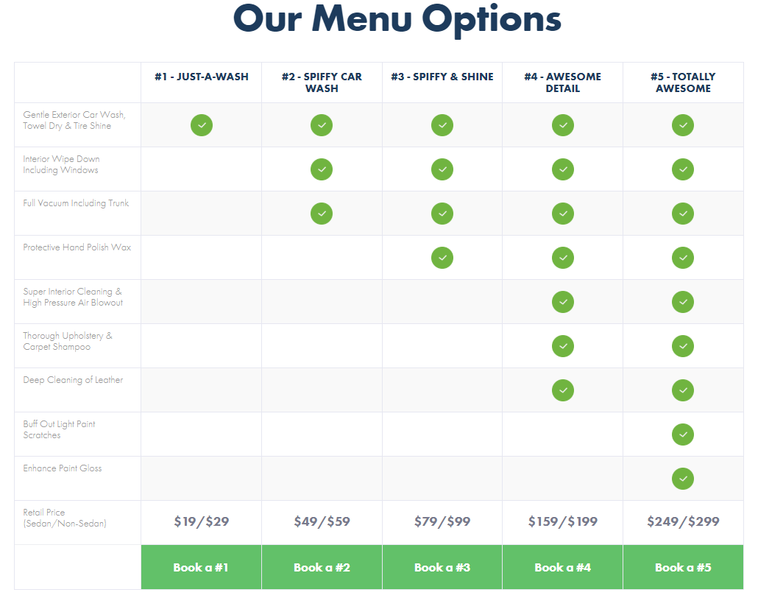
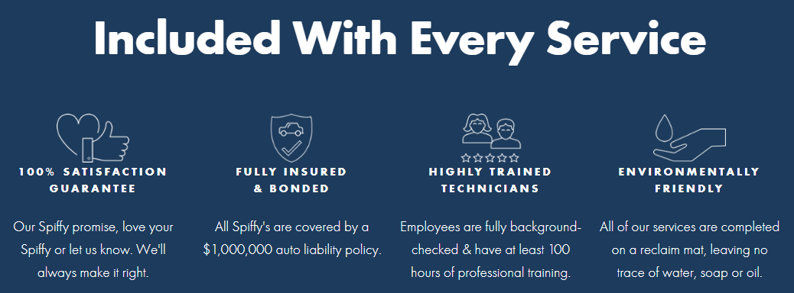
Competitors
Spiffy
www.getspiffy.com
Spiffy has a fully integrated application that allows customers to conveniently schedule, track and pay for mobile car washing services.
Based out of North Carolina, Spiffy is an eco-friendly car wash that has expanded from privately owned vehicles to fleet care services.

Slide 25
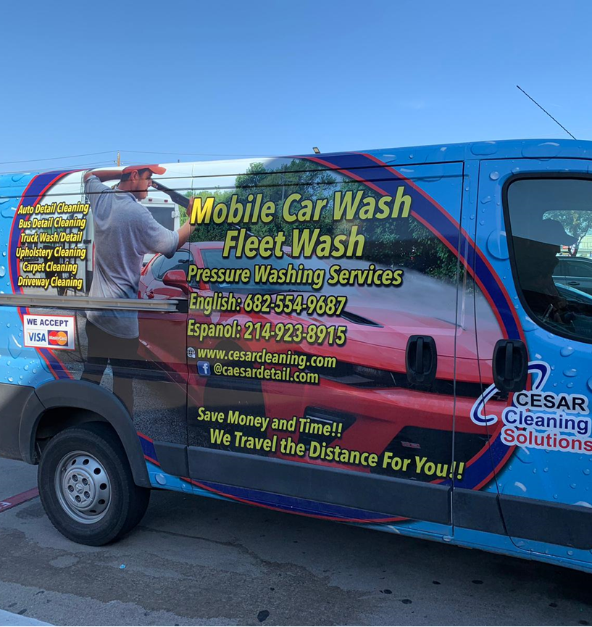

Competitors
Cesar Cleaning Solutions
Cesar Cleaning Solutions is a mobile car wash that is expanded to fleet washing as well.
Based in Arlington, Cesar Cleaning Solutions also provides driveway, upholstery and carpet cleaning services.
Contact is only available through calling and their social media.

Slide 26
Projected Financials
First Year
MARKETING BUDGET
 | MARCH | APRIL | MAY | JUNE | JULY | AUGUST | SEPTEMBER | OCTOBER | NOVEMEBER | DECEMBER | JANUARY | FEBRUARY | TOTAL
WEBSITE & MAINTENANCE | $500 | $100 | $100 | $100 | $100 | $100 | $100 | $100 | $100 | $100 | $100 | $100 | $1,600
MOBILE APP & MAINTENANCE | $500 | $100 | $100 | $100 | $100 | $100 | $100 | $100 | $100 | $100 | $100 | $100 | $1,600
SOCIAL MEDIA ADVERTISING | $300 | $300 | $300 | $400 | $400 | $400 | $400 | $400 | $500 | $500 | $500 | $500 | $4,900
1st PHASE DISCOUNTS | $2,000 | $2,000 | $2,000 |  |  |  |  |  |  |  |  |  | $6,000
2nd PHASE DISCOUNTS |  |  |  | $800 | $800 | $800 | $600 | $600 | $600 | $1,000 | $1,000 | $1,000 | $7,200
PRINT ADVERTISING | $400 |  | $200 |  | $100 |  | $100 |  | $100 |  | $100 |  | $1,000
LOCAL PROMOTION | $200 | $200 | $200 |  |  | $100 |  |  | $100 | $100 |  |  | $900
EXPENSES

